Slide 1
Virtual Personal Assistant J.A.R.V.I.S

Slide 2

Submitted to
DR.MD Firoz Mirdha
Associate Professor,
Department of Computer Science and Engineering CSE,
Bangladesh University of Business and Technology (BUBT)
Submitted by
Syeda Nowshin Ibnat (ID: 17183103020)
Nusrat Jahan Anka (17183103008)
Emadul Islam Sovon (17183103011)
Shamrima Eye Noon Huda(17183103006)
Intake 39 (Sec-01)
Department of Computer science and Engineering (CSE)

Slide 3
Table of Contents
Introduction
Objectives
Description of the system
System Architecture
Software Specification
Future Works
Conclusion
Reference

Slide 4
01
Introduction

Slide 5
Personal Virtual Assistants are programs that help us to ease our day to day tasks, such as taking a note, search on browsers etc.
They can take commands via text (online chat bots) or by voice.
Voice based intelligent assistants need an invoking word or wake word to activate the listener, followed by the command.
For our project the wake up word is used.
We have so many virtual assistants, such as Apple’s Siri, Amazon’s Alexa and Microsoft’s Cortana. We aims to develop our system from the inspiration of the current virtual assistants.

Slide 6
02
Objectives

Slide 7
As a personal assistant, Jarvis assists the end-user with day-to-day activities like general human conversation, searching queries in various search engines like Google, Bing or Yahoo, Searching for videos, etc.
Virtual assistants can tremendously save our time. JARVIS can do that for us.
One of the main advantages of voice searches is their rapidity. In fact, voice is reputed to be four times faster than a written search: whereas we can write about 40 words per minute, we are capable of speaking around 150 during the same period of time.

Slide 8
03
Description
of the System

Slide 9
We aims to build a system to being capable of voice interaction, music playback, making notes, setting alarms, providing weather condition and other real-time information, such as news.
This Virtual assistant enable users to speak natural language voice commands in order to operate the system.
In this ever-evolving digital world where speed, efficiency, and convenience are constantly being optimized.The mass adoption of artificial intelligence in users’ everyday lives is also fueling the
shift towards voice. It’s clear that we are moving towards less screen interaction.

Slide 10
04
System Architecture

Slide 11
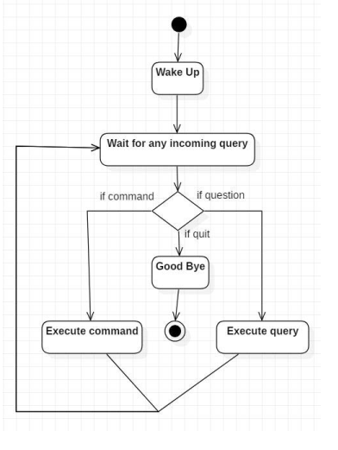
Activity Diagram

Slide 12
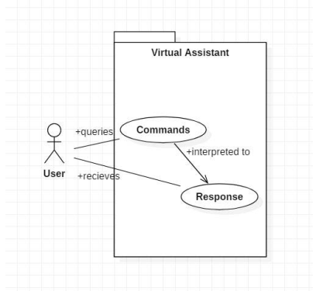
Use case Diagram

Slide 13
05
Software
Specification

Slide 14
This system is being built keeping in mind the generally available hardware and software compatibility. Here are the minimum software requirements for our project.
Windows 10 or above
Python 3.8 or later
Pycharm

Slide 15
06
Future Works

Slide 16
We plan to Integrate Jarvis with IoT to do home automation tasks.
Further, in the long run, Jarvis is planned to add more features so that it can become more intelligent.

Slide 17
07
Conclusion

Slide 18
As a personal assistant, Jarvis assists the user with ​day-to-day activities. We tried our best to make it user-friendly.
The main reason for choosing this project is to make users’ life easier with technology.
We aim to make this project smart enough for the users to make their life a little bit easier.

Slide 19
08
Reference

Slide 20
Websites
www.pythonprogramming.net
www.codecademy.com
www.tutorialspoint.com
www.google.co.in
YouTube Channels
CS Dojo
Edureka!

Slide 21
Thanks!
Do you have any question?

